Slide 1
Augmented Reality Tourism Application
Steven Li, Dr. Sven Fuhrmann

Slide 2
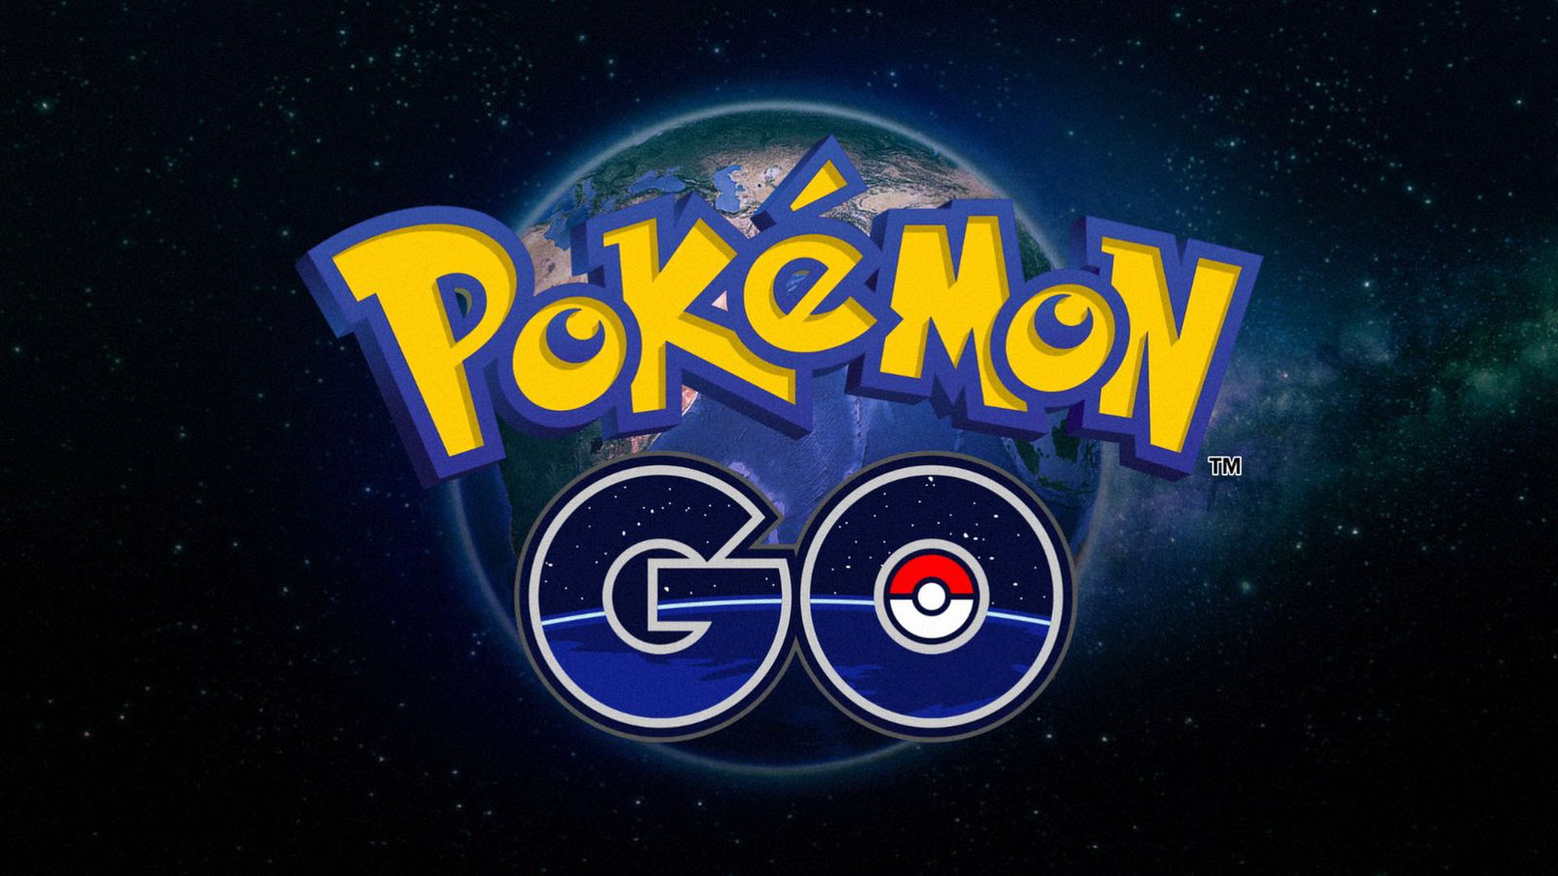
What is Augmented Reality?
Augmented reality produces virtual objects and combines them with 3D real-time video feed to enhance user’s perception of the physical world.
This feature can be implemented in mobile devices that, upon scanning a target, create a platform of additional information for the user

Slide 3
Goal
This research explores augmented reality and it’s function of target recognition for tourism applications such as information stands.
Create a comprehensive tour guide for the entire GMU campus

Slide 4

Methodology
Using Vuforia and Unity
C# scripts to create functions for GameObjects
Exported through Xcode into an Apple device

Slide 5
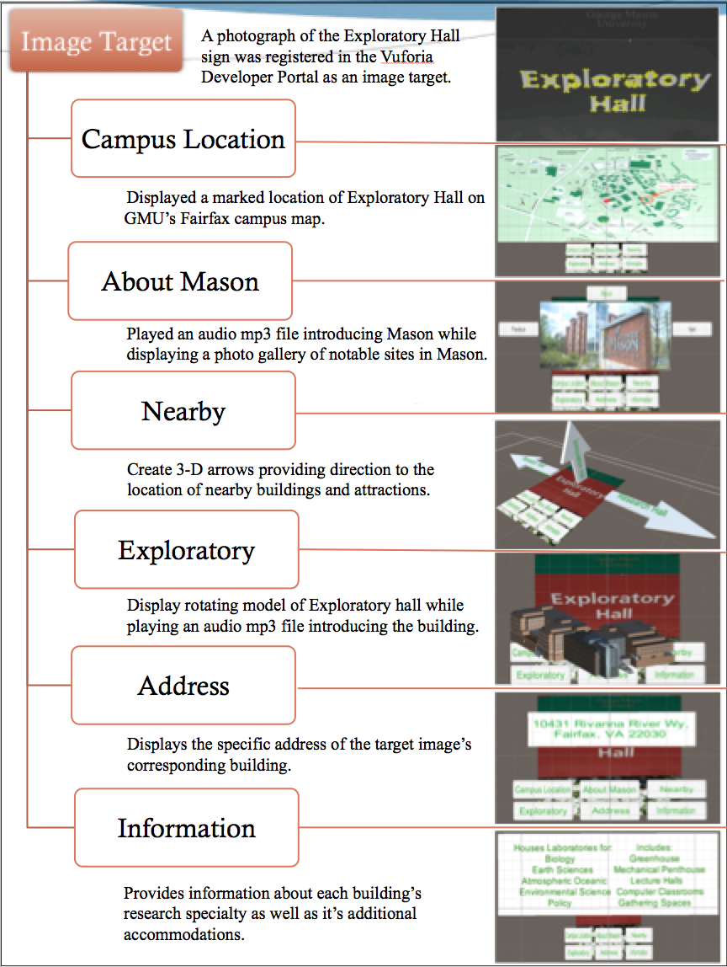

Slide 6
Potential Difficulties
Exporting it on Android Developer
Storage Space
Video Playback

